Slide 1



#GHC15
Open Source Continuous Integration System
Elizabeth K. Joseph
@pleia2
15 October 2015
2015

Slide 2
OpenStack Infrastructure
Maintains developer infrastructure for the OpenStack project
Runs a fully open source Continuous Integration (CI) system for OpenStack commits
Elizabeth has worked on it for nearly 3 years, is a core/root member of the team
http://docs.openstack.org/infra/

Slide 3
Continuous Integration
“The practice, in software engineering, of merging all developer working copies to a shared mainline several times a day… In addition to automated unit tests, organisations using CI typically use a build server to implement continuous processes of applying quality control in general” Source:https://en.wikipedia.org/wiki/Continuous_integration
Jenkins
Travis CI, CircleCI

Slide 4
OpenStack
Commitment to all open source
CI is essential for a complex system that has a diverse development team

Slide 5
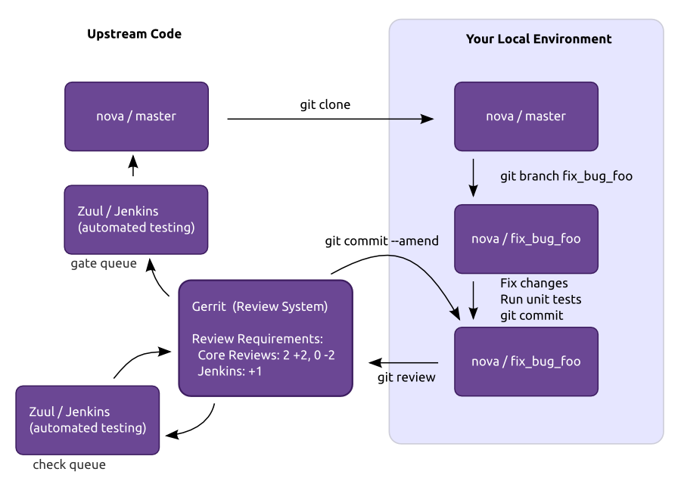
Developer work flow

Slide 6
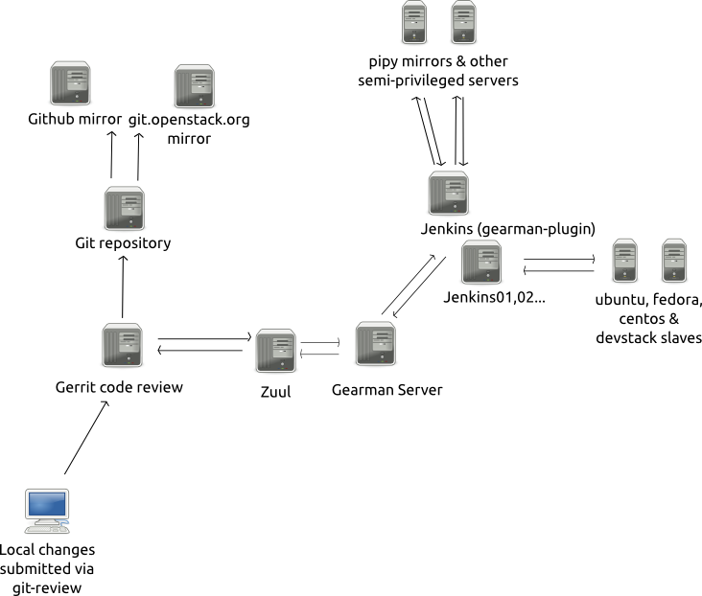
Infrastructure set up

Slide 7
Git
Revision control
HAProxy, cgit and git-daemon for 8 node git cluster accessible via git.openstack.org
Mirror to GitHub (not open source)

Slide 8
Gerrit
Code review https://www.gerritcodereview.com/
Gerrit server at https://review.openstack.org
Open to everyone to propose code*, view proposed changes and do code reviews
* OpenStack requires a Contributor License Agreement to be signed in order to submit code to the project

Slide 9
Zuul
Project gating, docs: http://docs.openstack.org/infra/zuul/
Manages change dependencies
Passes jobs to testing systems
View jobs in action at http://status.openstack.org/zuul/

Slide 10
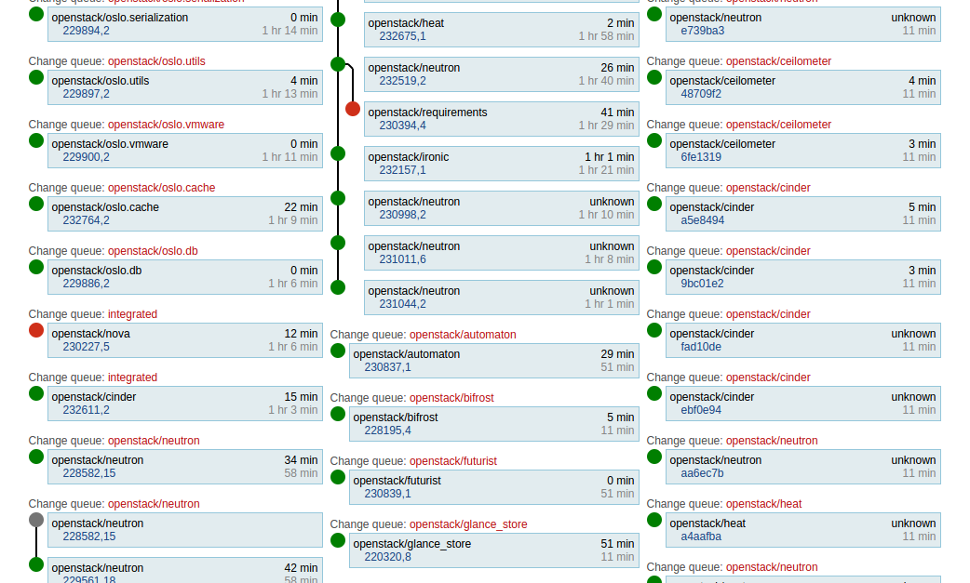

Slide 11
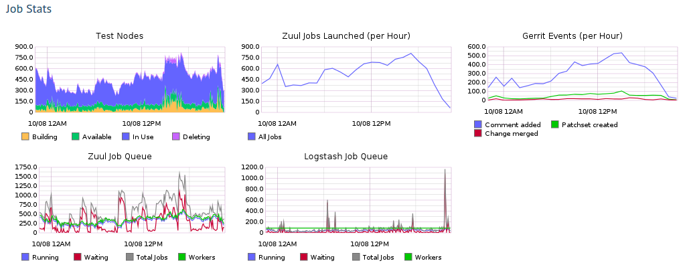

Slide 12
Gearman
Application framework to farm out work to other machines or processes http://gearman.org/
Hands off jobs to the Jenkins server that meets the appropriate requirements

Slide 13
Jenkins
Extensible, open source continuous integration server, https://jenkins-ci.org/
Fleet of 8 Jenkins servers

Slide 14
Jenkins Job Builder
Takes simple descriptions of Jenkins jobs in YAML or JSON format and uses them to configure Jenkins, docs: http://docs.openstack.org/infra/jenkins-job-builder/
Easy to manage submissions from developers in revision control

Slide 15
Nodepool
A system for launching single-use test nodes, docs: http://docs.openstack.org/infra/nodepool/
Manages 800+ servers across multiple clouds, public and private

Slide 16
ELK stack
Elasticsearch, Logstash and Kibana
Kibana interface at http://logstash.openstack.org/
Search for failures, run automated scripts to track failures (elastic-recheck)

Slide 17

Got Feedback?
Rate and review the session on our mobile app
Download at http://ddut.ch/ghc15
or search GHC 2015 in the app store
Notes:
This is the last slide and must be included in the slide deck
<number>

